Slide 1




VOIS Innovation
Marathon 2.0

Slide 2


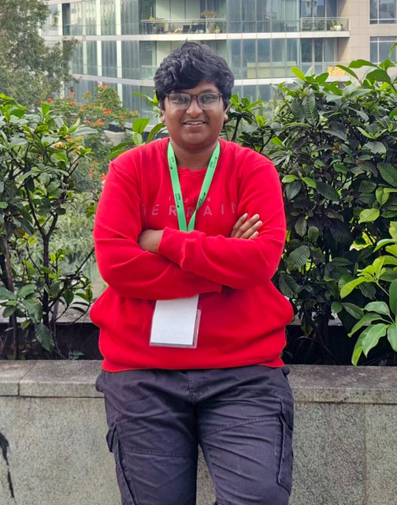

WEBSHIELD: Advanced Web and Email Security
Team No. 68
Deepu G, ISE
Sri Venkateshwara College of Engineering, Bengaluru, Karnataka
Deepak Prasad S, AI
Aishu A Parekar, AI

Slide 3
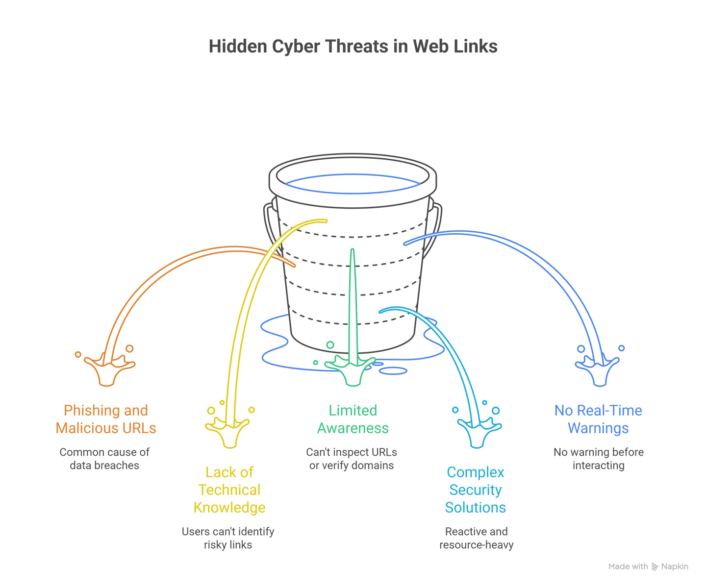
Problem Statement
Users regularly receive web links that appear safe but contain hidden cyber threats
Phishing and malicious URLs are one of the most common causes of data breaches
Most users lack the technical knowledge to identify risky links before clicking. Users get malicious links not only while browsing websites, but also inside emails (especially Gmail), where phishing links are common.
The majority of users lack the technical awareness to inspect URLs, verify domains, or detect subtle red flags (e.g., typosquatting, shortened links, fake HTTPS).
There is no simple, real-time mechanism to warn users before interacting with malicious websites

Slide 4
Need of Project
Web users are increasingly exposed to malicious and deceptive websites that closely resemble legitimate ones, making them difficult to identify.
Most cyber attacks rely on tricking users into clicking unsafe links, while users lack sufficient awareness of phishing indicators and suspicious URLs.
Existing security solutions mainly detect threats after user interaction, which is often too late to prevent data theft or system compromise.
There is a growing gap between rapidly evolving cyber threats and user-level cybersecurity awareness.
Users are not provided with real-time guidance or explanations, leading to repeated mistakes and unsafe browsing behavior.
Therefore, a real-time preventive solution that also educates users while browsing is necessary to ensure safer web interactions.

Slide 5
Proposed Solution
WebShield is an advanced AI-powered URL scanning and phishing detection platform designed to stop threats before the user clicks.
It uses a multi-engine security architecture that combines:
Threat Intelligence (VirusTotal): Enriches every URL with reputation signals, known malware/phishing indicators, and community/vendor detections.
Machine Learning Risk Scoring: Detects suspicious patterns using URL structure + domain signals + content/behavioral indicators, enabling fast detection even for previously unseen (zero-day) phishing links.
LLM-Based Classification & Explanation (Groq-powered)
Produces a human-readable decision, explaining why a link is risky, summarizing key red flags, and providing actionable safety tips for users.
Extension: 2 Extensions provided with Normal extension: real-time web protection
and Gmail extension for gmail threats. UI

Slide 6
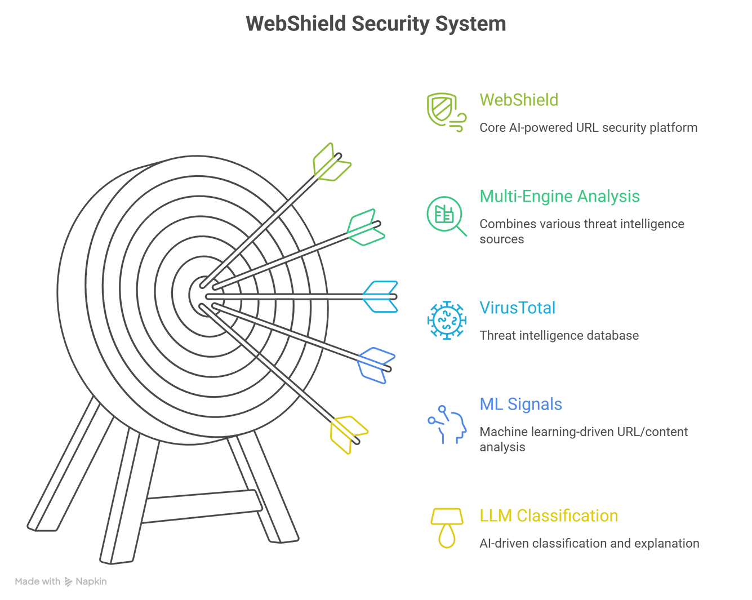
Solution Overview
WebShield — Advanced AI-Powered URL scanning and phishing detection platform.
A multi-engine URL security analysis system combining:
VirusTotal threat intelligence
ML-driven URL/content signals
LLM-based classification + explanation using Groq
It analyzes URLs before user interaction
The system detects phishing, malware, and suspicious links instantly
Works as a web application and browser extension for both gmail and web
Provides clear risk classification with easy-to-understand explanations and tips on
how to stay away from threats.

Slide 7
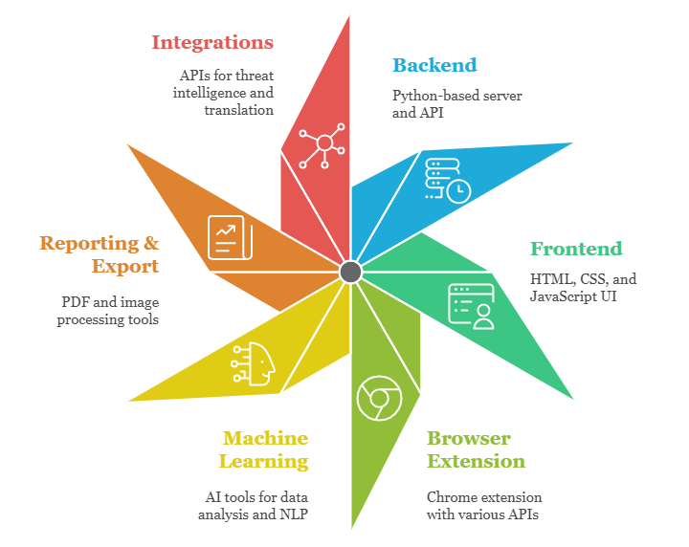
Technology used
INTEGRATIONS
VirusTotal API (threat intelligence)
Groq API (LLM Explainations)
BACKEND (Server/API) :
Language: Python
Framework: FastAPI
Server: Uvicorn (ASGI)
Database: MySQL, ChromaDB.
ORM: SQLAlchemy + mysql-connector-python
Auth: PyJWT, passlib, bcrypt
Frontend :
HTML5 + CSS3 + Vanilla JavaScript
PWA Support: manifest.json, service-worker.js
BROWSER EXTENSION
Platform: Chrome/Chromium (Manifest V3)
APIs: chrome.storage, chrome.tabs, chrome.notifications, chrome.contextMenus, activeTab
MACHINE LEARNING / AI
ML Core: scikit-learn, numpy, scipy, pandas, joblib
NLP: transformers, sentencepiece, accelerate
Content Parsing: beautifulsoup4

Slide 8
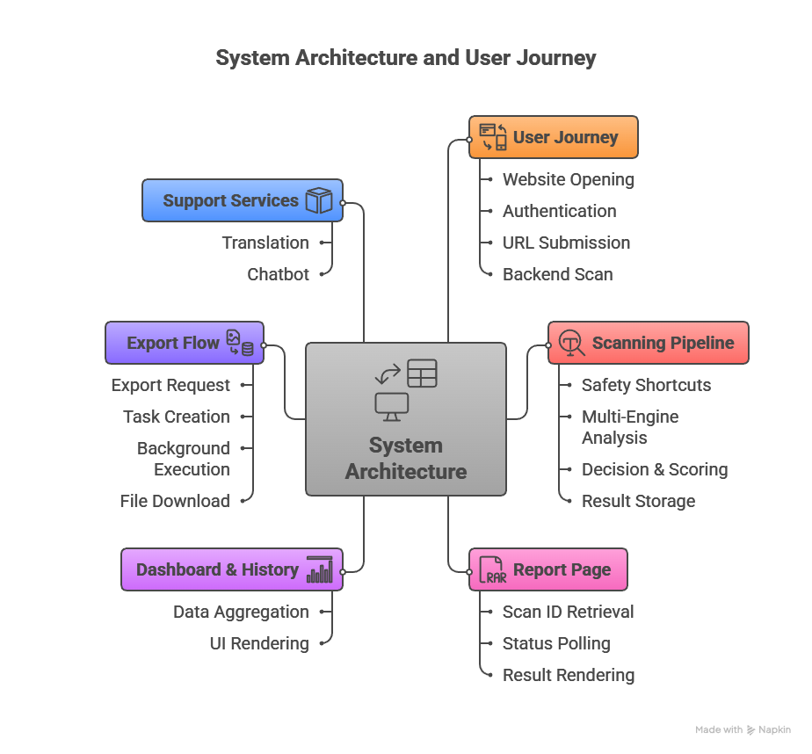
Technical flow diagram -

Slide 9
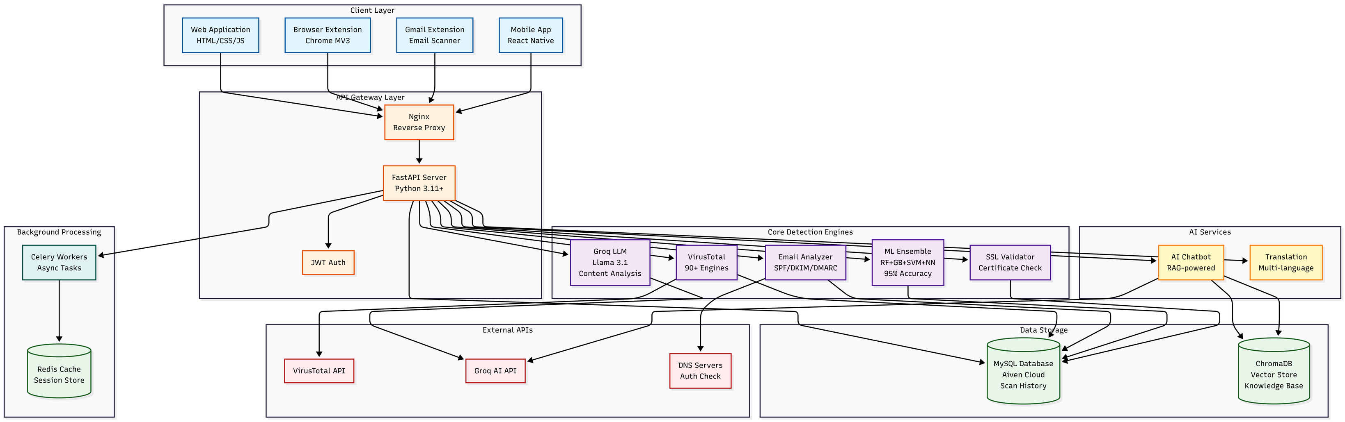
Architecture Blueprint

Slide 10
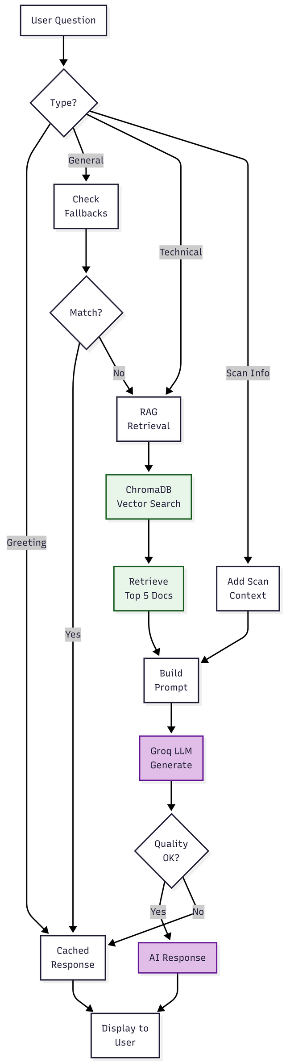
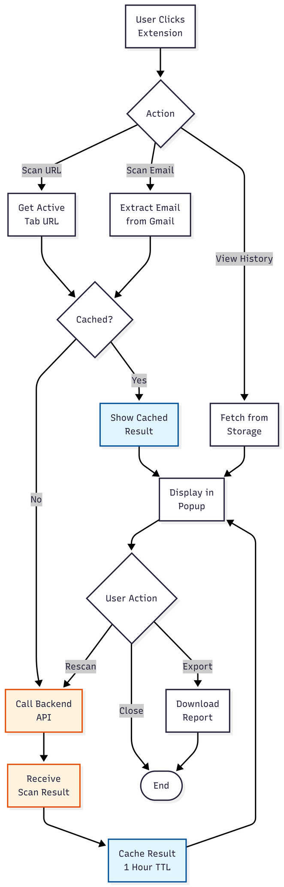
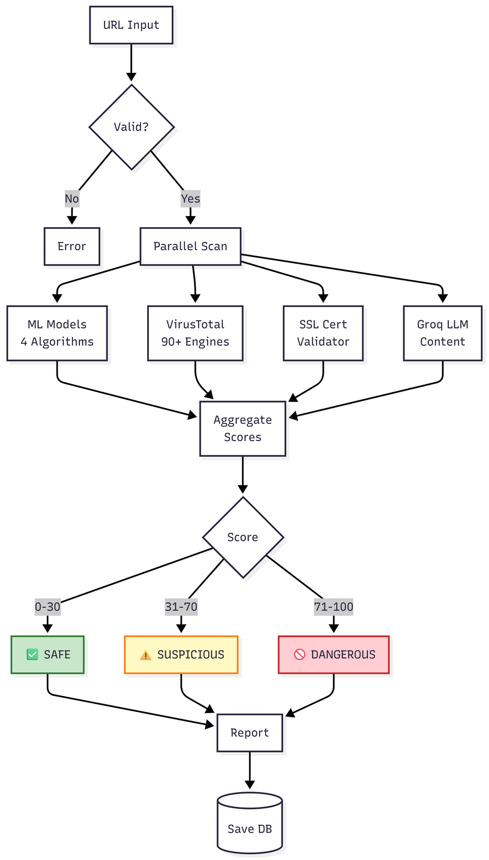
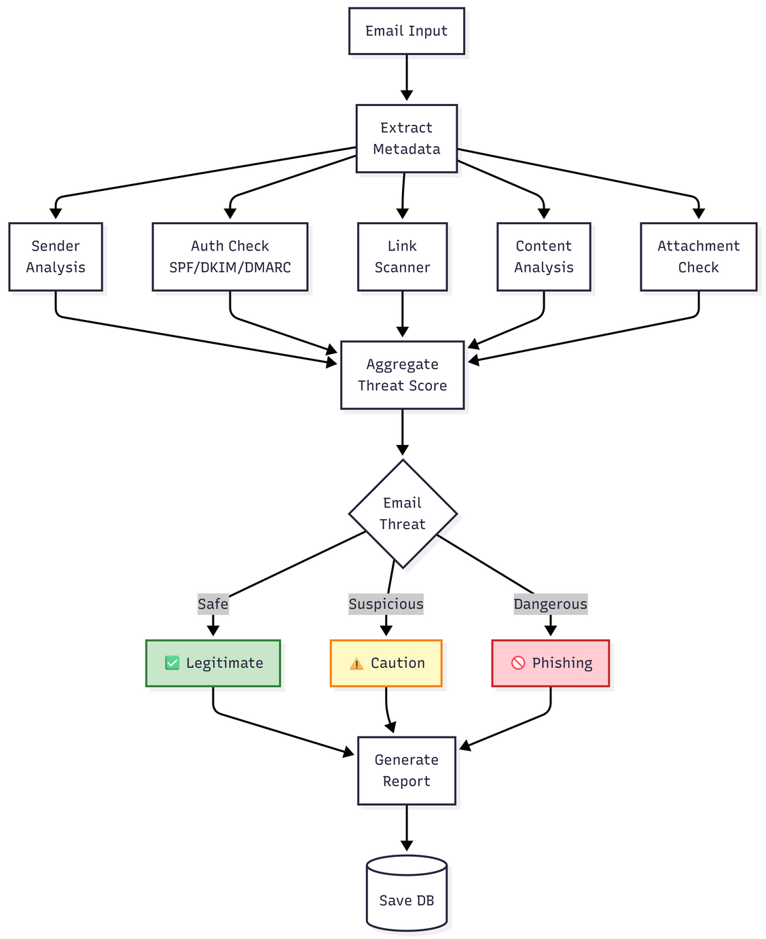
Workflow diagrams
BACKEND Scan workflow
diagram
Email Scan workflow
diagram
RAG Chatbot workflow
diagram
Extension workflow
diagram

Slide 11
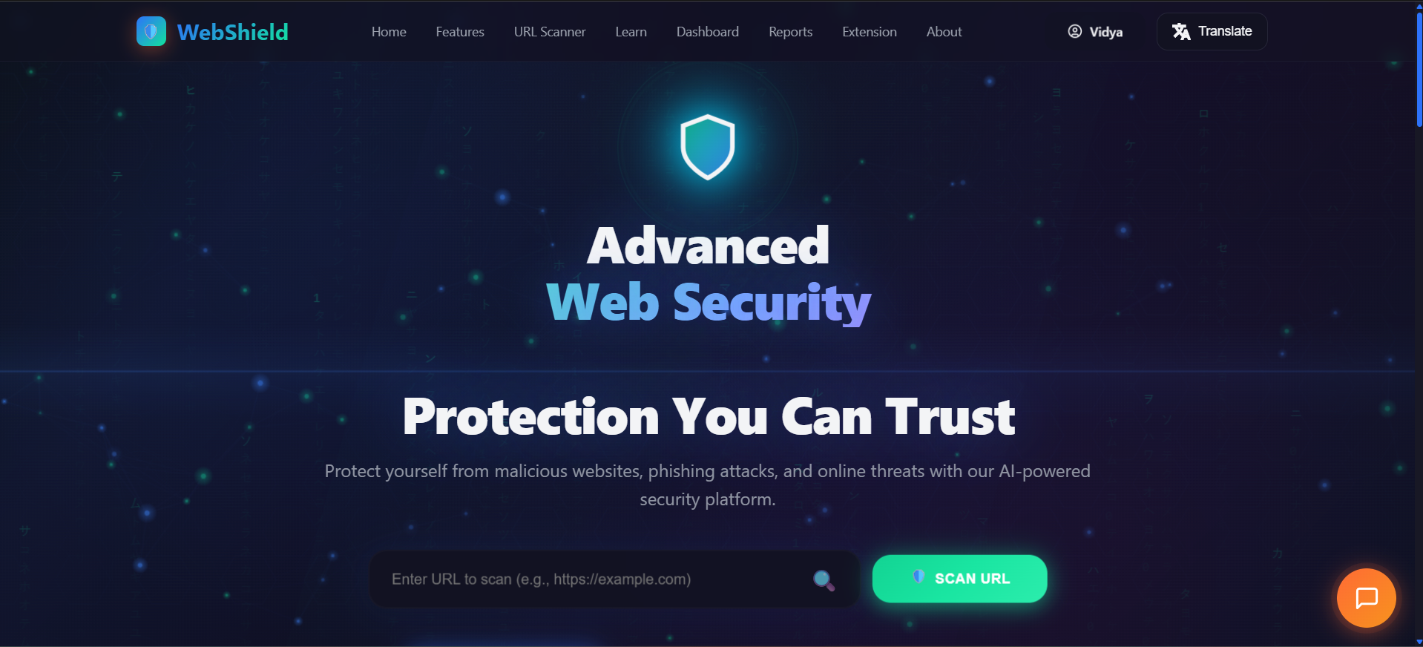

Slide 12
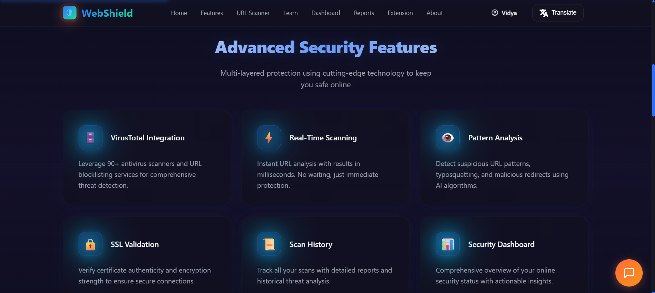

Slide 13
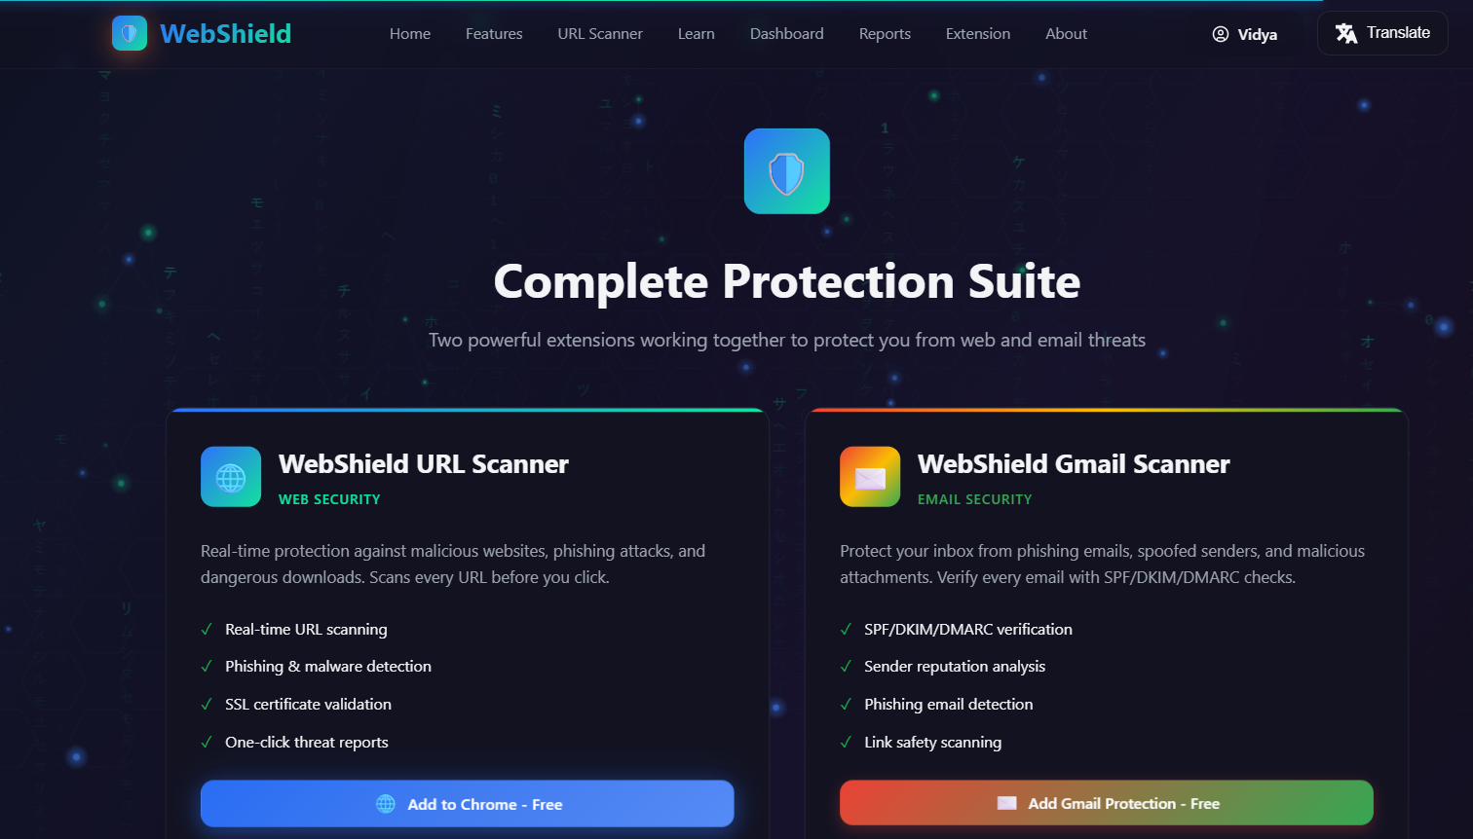

Slide 14
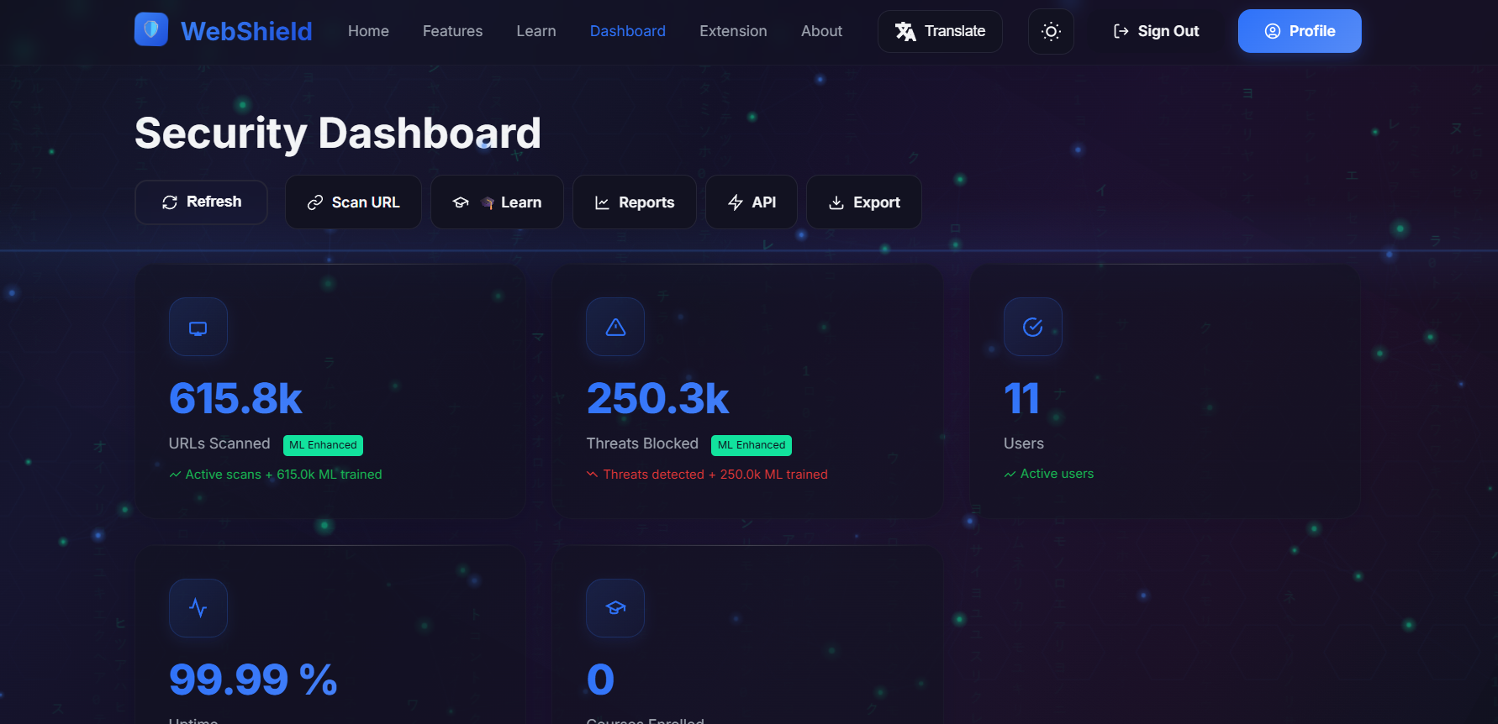

Slide 15
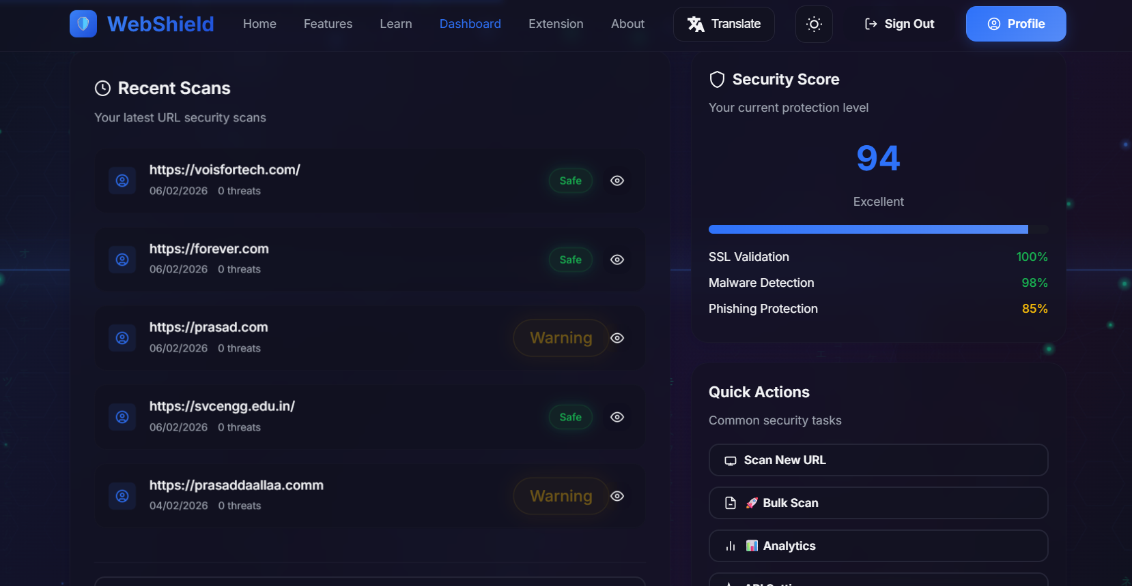

Slide 16
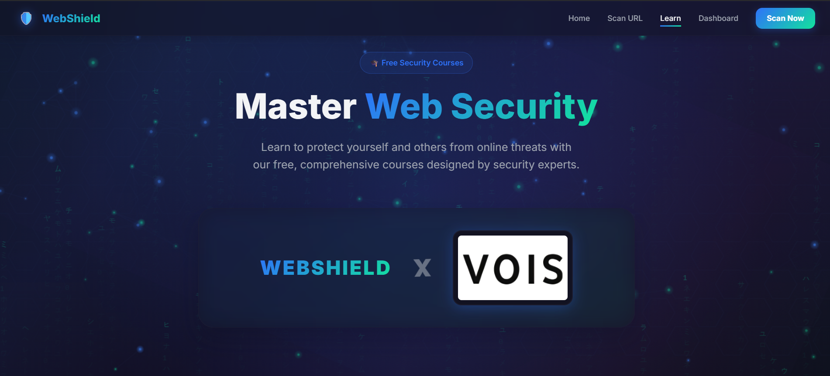

Slide 17
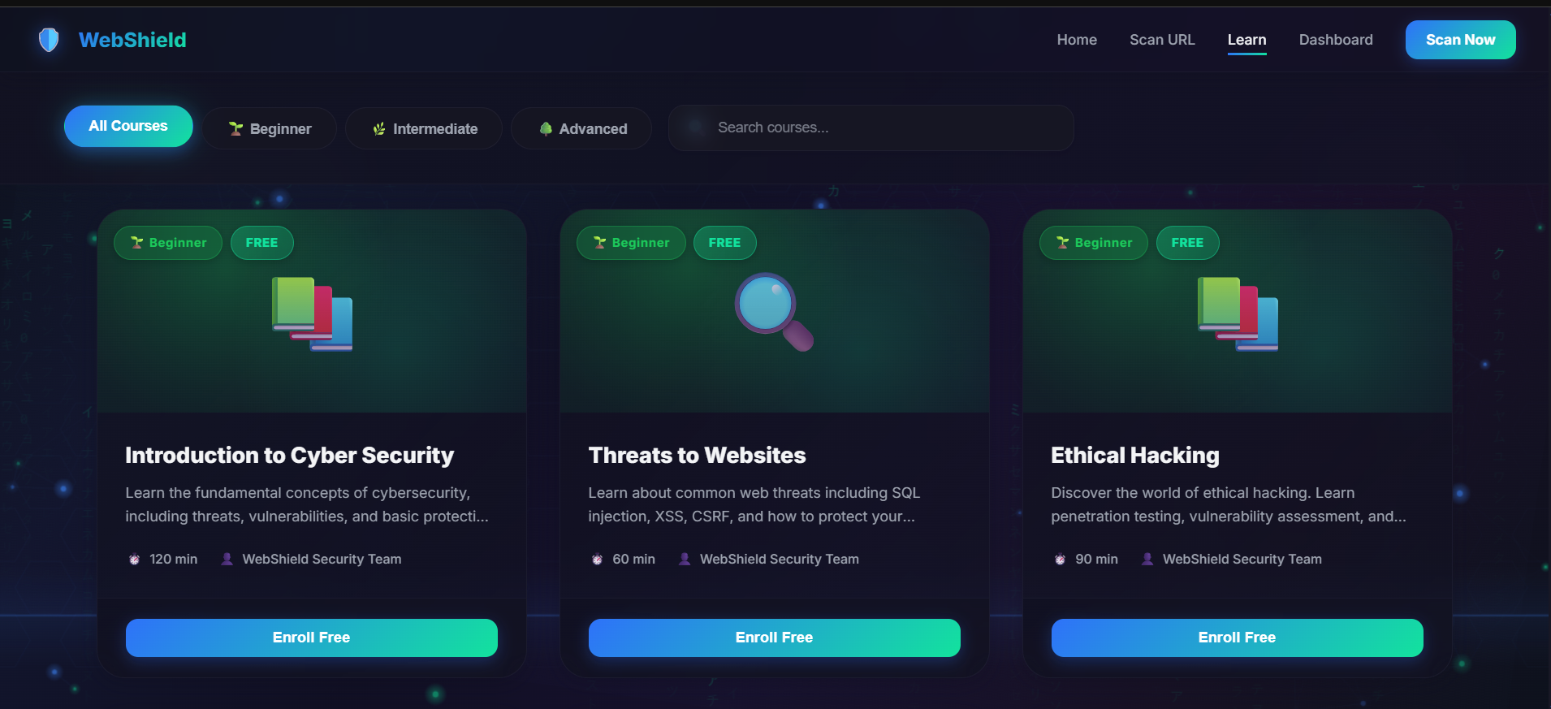

Slide 18
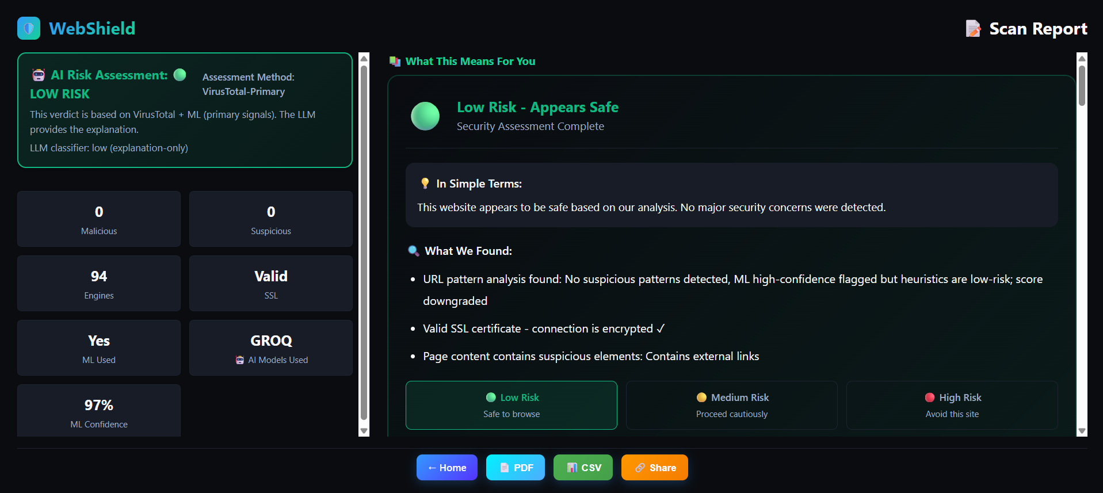

Slide 19
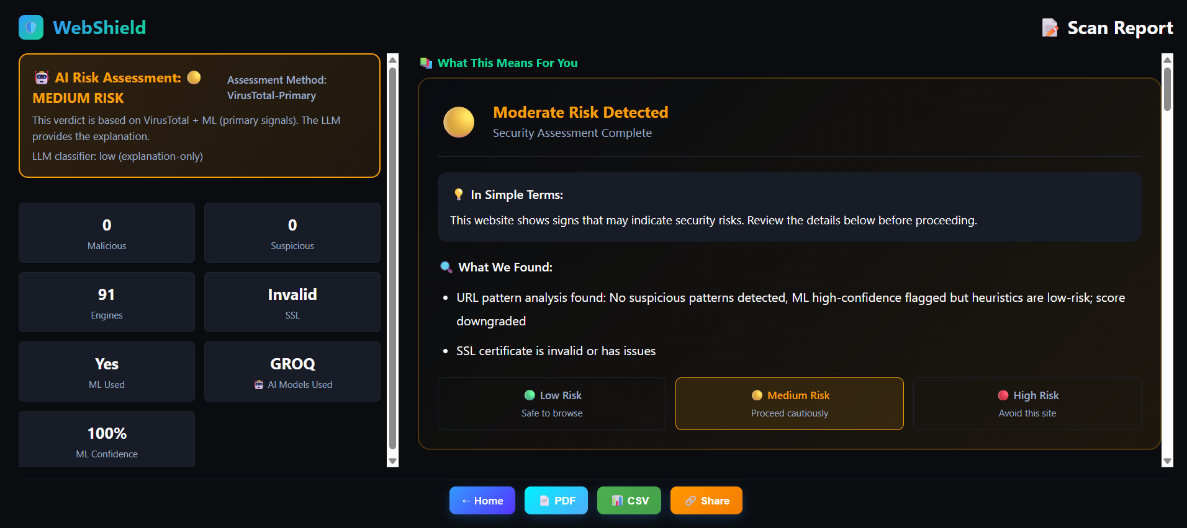

Slide 20
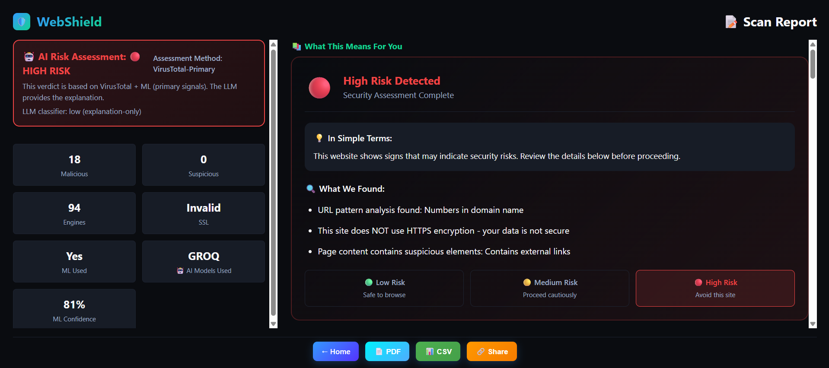

Slide 21
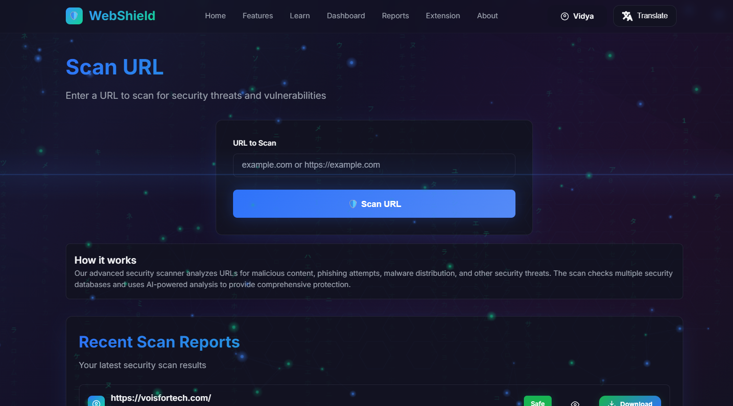

Slide 22
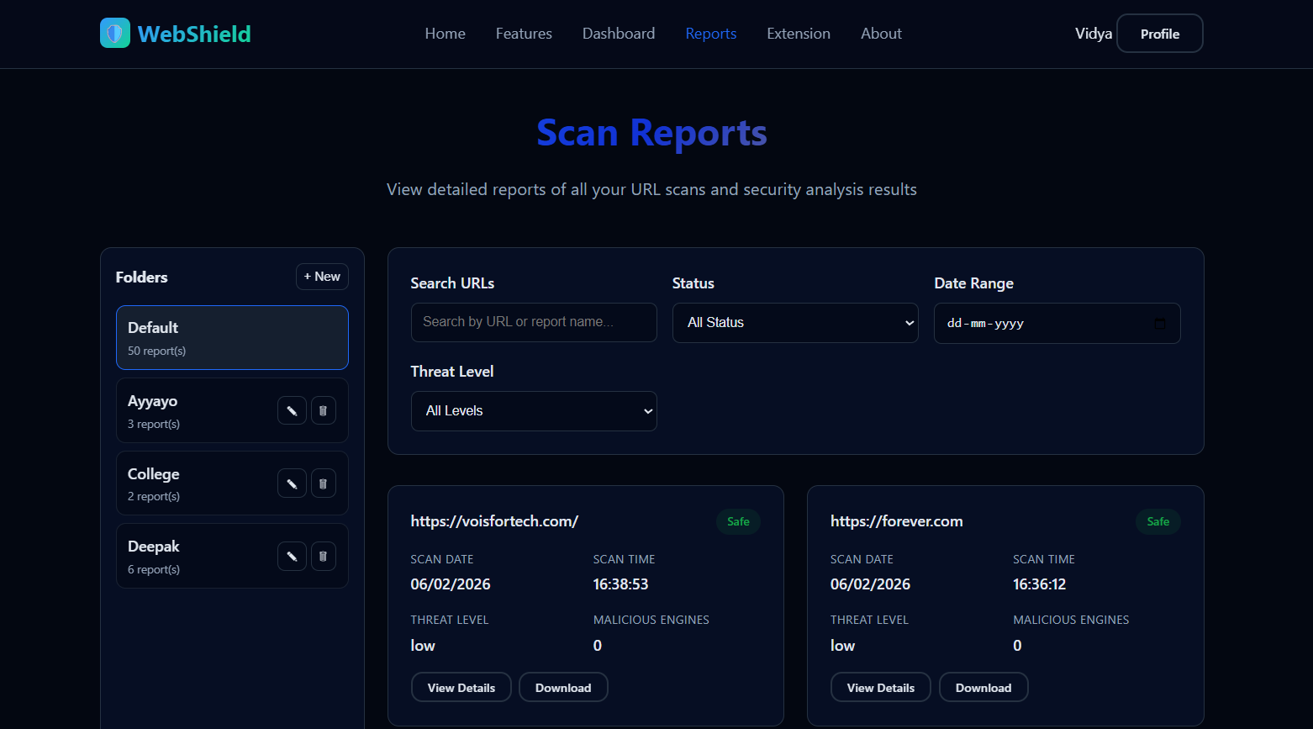

Slide 23
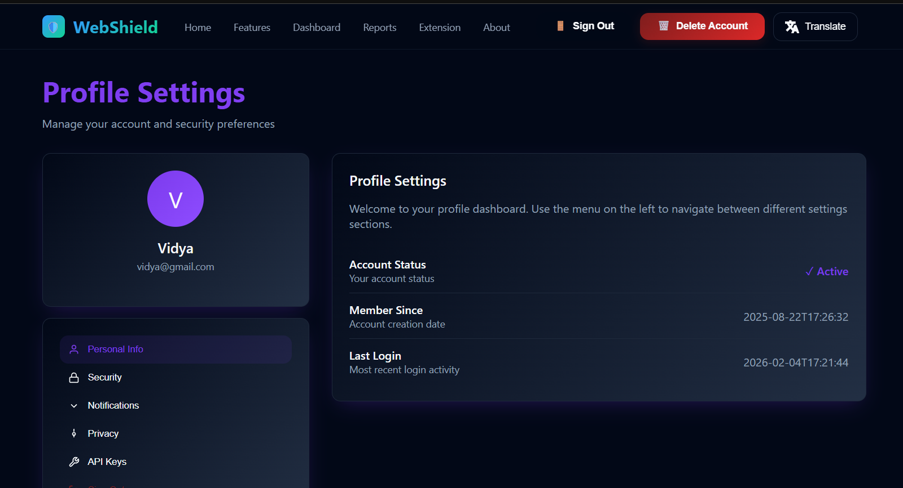

Slide 24
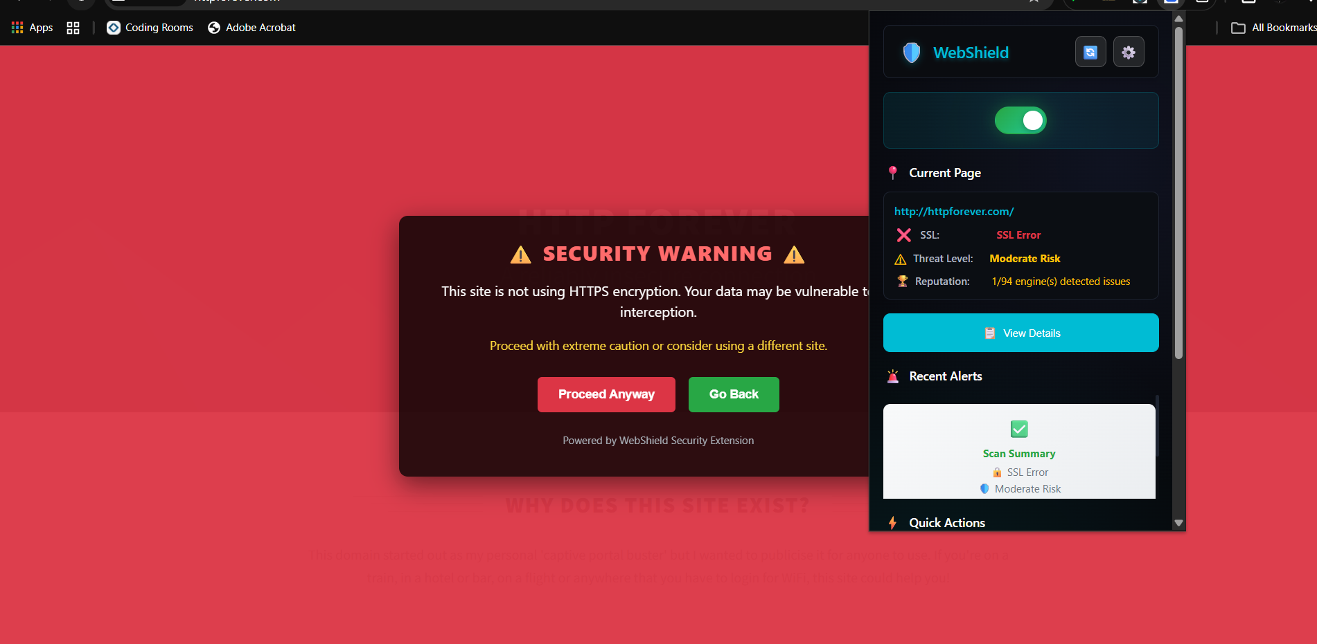

Slide 25
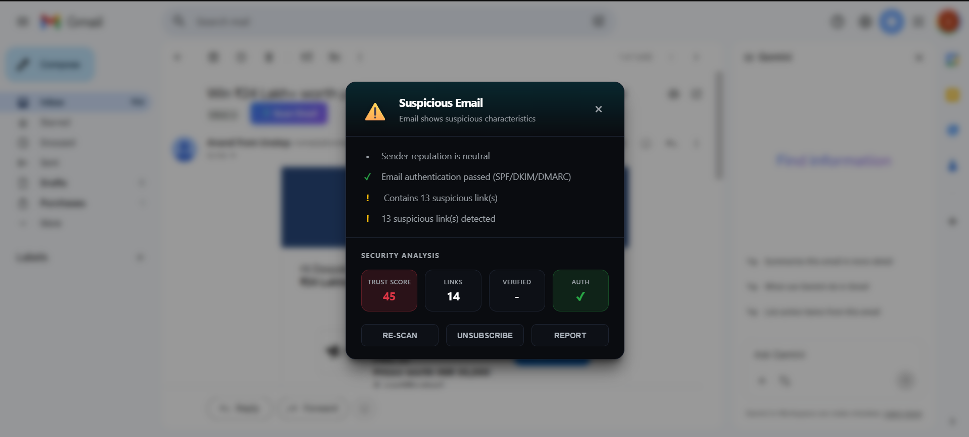

Slide 26
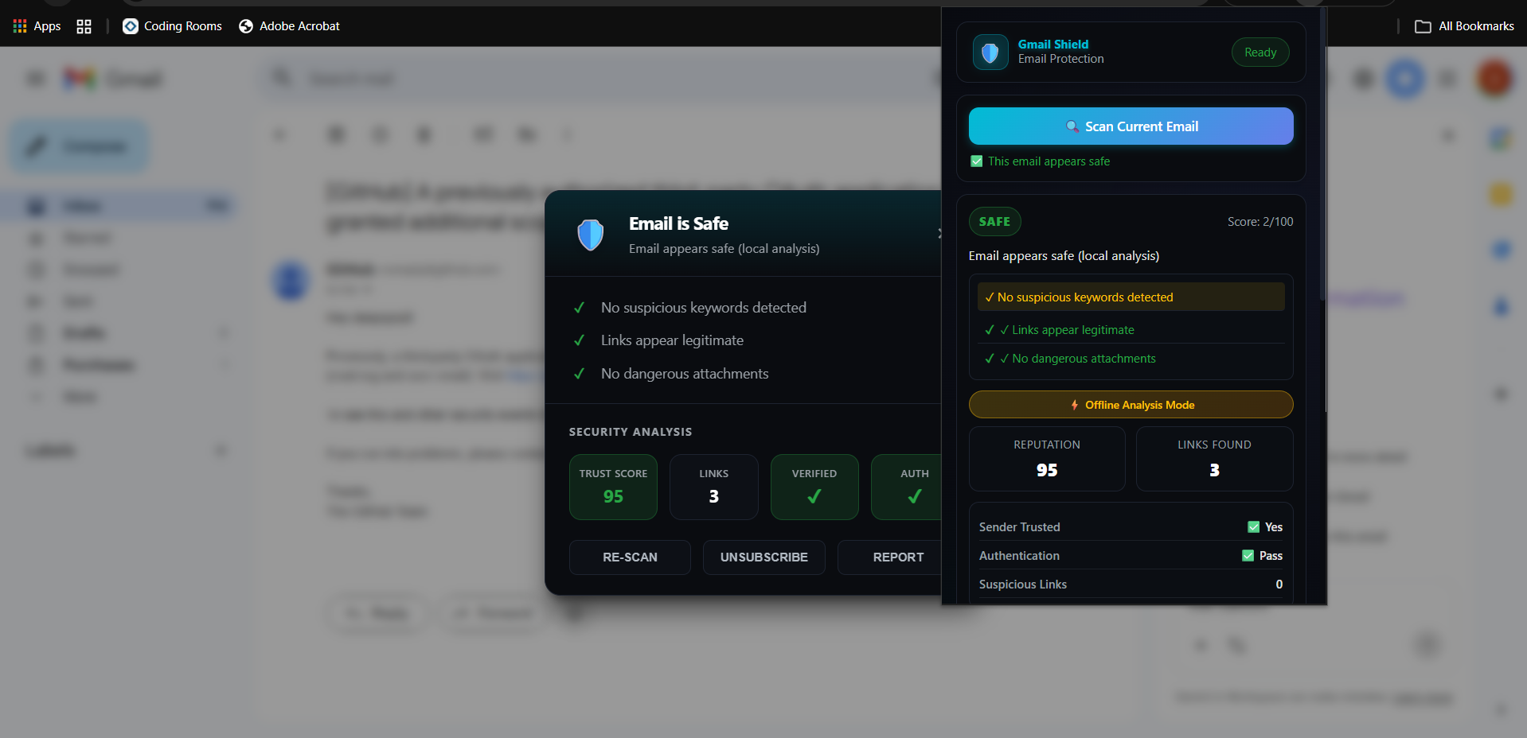

Slide 27
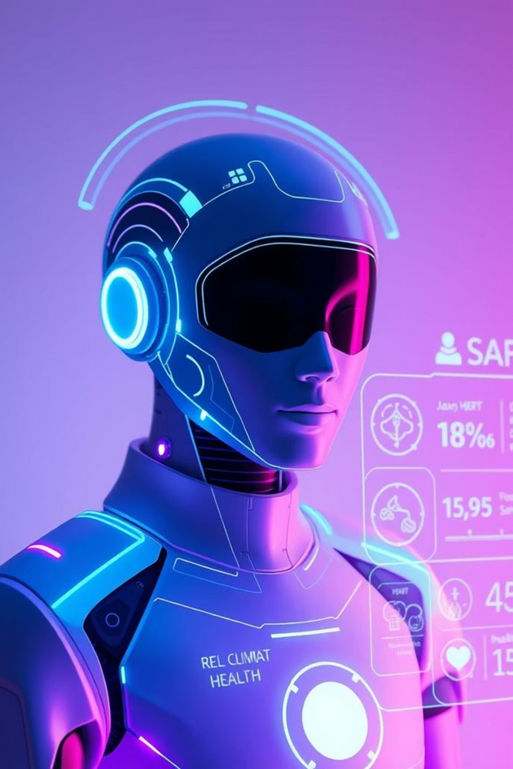
Role of Gen AI in the solution
The GenAI Components in WebShield:
Groq LLM (Llama 3.1) - Content Generation & Analysis
What it does:
Deep Content Understanding: Groq LLM (Llama 3.1) analyzes webpage content beyond keywords, detecting social engineering tactics, urgency manipulation, and credential harvesting patterns
Contextual Explanation: Generates human-readable threat reports explaining why a URL is dangerous, not just that it's dangerous
Adaptive Learning: Understands new phishing templates and attack vectors without manual rule updates
RAG-Powered Chatbot - Knowledge Retrieval & Generation
What it does:
Retrieves relevant security knowledge from ChromaDB vector database
Generates contextual answers by combining retrieved knowledge with LLM reasoning
Technical Implementation:
Uses ChromaDB for vector embeddings of legal docs, security policies, threat intelligence
HashingVectorizer creates 1024-dimensional embeddings
Groq LLM generates responses using top-5 retrieved knowledge chunks

Slide 28









Novelty and Uniqueness
1
2
3
4
Real-Time VirusTotal Integration with Intelligent Rate-Limit Management
and
True Hybrid Multi‑Engine Verdict
Context-Aware Security Education System
and
Context-Aware "What To Do" Recommendations
Browser extension: online + offline protection, endpoint auto-discovery
Typosquatting Detection with Brand Matching
along with
Risky Attachment Classification

Slide 29
Git Hub Link
GitHub URL
– https://github.com/deepspsd/webshield.official

Slide 30
Future Scope
Advanced AI Threat Prediction
Enhance Machine Learning models to predict emerging web threats using behavioral
and pattern-based analysis, or Integrate Deep learning model for better detection.
LLM-Guided Personalized Learning
Adapt cybersecurity learning content based on user behavior, scan history, and risk exposure.
Community-Driven Threat Intelligence
Enable users to report suspicious websites and contribute to a shared threat intelligence system.
Advanced Analytics Dashboard
Provide insights into browsing risk trends, threat categories, and user learning progress.
Expanded Learning Modules
Introduce role-based cybersecurity courses for students, professionals, and organizations.
Performance & Scalability Optimization
Improve scanning speed, API efficiency, and system scalability for larger user bases.
Cross-Browser & Platform Expansion
Extend WebShield support to multiple browsers and devices.

Slide 31

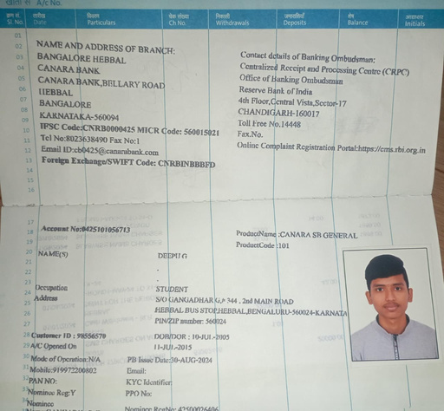
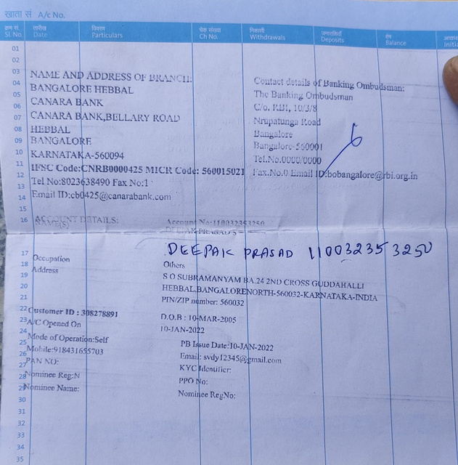
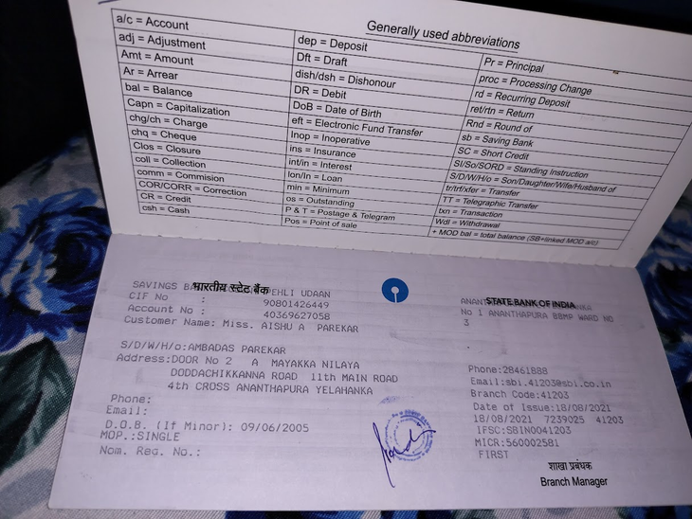
Bank Details
Full Name (as per bank records): | Bank Name | Branch Name | Account Number | Account Type (Savings / Current) | IFSC Code
Deepu G | Canara Bank | Hebbala | 0425101056713 | savings | CNRB0000425
Aishu A Parekar | SBI | Ananthapura | 40369627058 | savings | SBIN0041203
Deepak Prasad S | Canara Bank | Hebbala | 110032353250 | Savings | CNRB0000425
Team Member 1
Passbook/ Bank Statement With Name and Account Number
Team Member 2
Passbook/ Bank Statement With Name and Account Number
Team Member 3
Deepak Prasad S

Slide 32
Thank You

